Slide 1
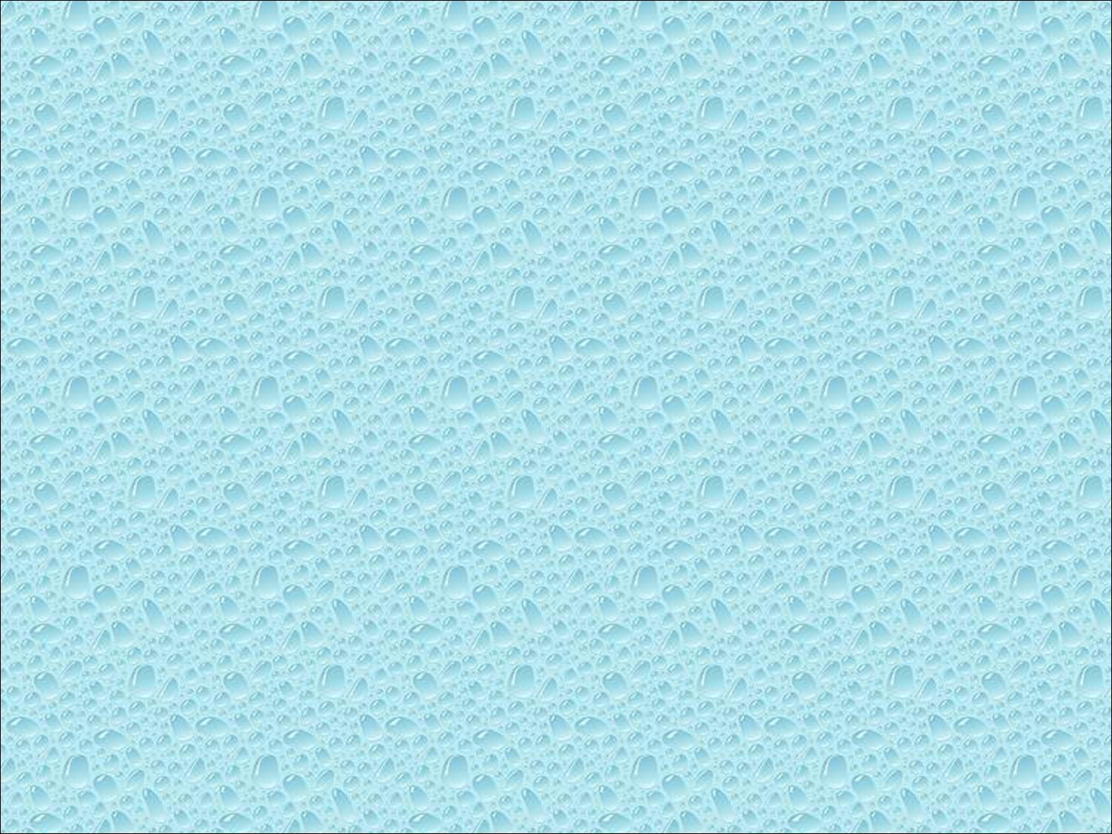


Slide 2

Learn to build interactive programs using GLUT callbacks
  Mouse
  Keyboard
  Reshape
Introduce menus in GLUT

Slide 3

glutMouseFunc(mymouse)
void mymouse(GLint button, GLint state, GLint x, GLint y)
Returns
  which button (GLUT_LEFT_BUTTON, GLUT_MIDDLE_BUTTON, GLUT_RIGHT_BUTTON) caused event
  state of that button (GLUT_UP, GLUT_DOWN)
  Position in window

Slide 4

The position in the screen window is usually measured in pixels with the origin at the top-left corner
  Consequence of refresh done from top to bottom
OpenGL uses a world coordinate system with origin at the bottom left
  Must invert y coordinate returned by callback by height of window
  y = h – y;
(0,0)
h
w

Slide 5

To invert the y position we need the window height
  Height can change during program execution
  Track with a global variable
  New height returned to reshape callback that we will look at in detail soon
  Can also use query functions
    glGetIntv
    glGetFloatv
  to obtain any value that is part of the state

Slide 6

In our original programs, there was no way to terminate them through OpenGL
We can use the simple mouse callback
void mouse(int btn, int state, int x, int y)
{
if(btn==GLUT_RIGHT_BUTTON && state==GLUT_DOWN)
exit(0);
}

Slide 7

In the next example, we draw a small square at the location of the mouse each time the left mouse button is clicked
This example does not use the display callback but one is required by GLUT; We can use the empty display callback function
  mydisplay(){}

Slide 8

void mymouse(int btn, int state, int x, int y)
{
if(btn==GLUT_RIGHT_BUTTON && state==GLUT_DOWN)
exit(0);
if(btn==GLUT_LEFT_BUTTON && state==GLUT_DOWN)
drawSquare(x, y);
}
void drawSquare(int x, int y)
{
y=w-y; /* invert y position */
glColor3ub( (char) rand()%256, (char) rand )%256, (char) rand()%256); /* a random color */
glBegin(GL_POLYGON);
glVertex2f(x+size, y+size);
glVertex2f(x-size, y+size);
glVertex2f(x-size, y-size);
glVertex2f(x+size, y-size);
glEnd();
}

Slide 9

We can draw squares (or anything else) continuously as long as a mouse button is depressed by using the motion callback
  glutMotionFunc(drawSquare)
We can draw squares without depressing a button using the passive motion callback
  glutPassiveMotionFunc(drawSquare)

Slide 10

glutKeyboardFunc(mykey)
void mykey(unsigned char key,
int x, int y)
  Returns ASCII code of key depressed and mouse location
void mykey()
{
if(key == ‘Q’ | key == ‘q’)
exit(0);
}

Slide 11

GLUT defines the special keys in glut.h
  Function key 1: GLUT_KEY_F1
  Up arrow key: GLUT_KEY_UP
    if(key == ‘GLUT_KEY_F1’ ……
Can also check of one of the modifiers
  GLUT_ACTIVE_SHIFT
  GLUT_ACTIVE_CTRL
  GLUT_ACTIVE_ALT
  is depressed by
  glutGetModifiers()
  Allows emulation of three-button mouse with one- or two-button mice

Slide 12

We can reshape and resize the OpenGL display window by pulling the corner of the window
What happens to the display?
  Must redraw from application
  Two possibilities
    Display part of world
    Display whole world but force to fit in new window
      Can alter aspect ratio

Slide 13

original
reshaped

Slide 14

glutReshapeFunc(myreshape)
void myreshape( int w, int h)
  Returns width and height of new window (in pixels)
  A redisplay is posted automatically at end of execution of the callback
  GLUT has a default reshape callback but you probably want to define your own
The reshape callback is good place to put viewing functions because it is invoked when the window is first opened

Slide 15

This reshape preserves shapes by making the viewport and world window have the same aspect ratio
void myReshape(int w, int h)
{
glViewport(0, 0, w, h);
glMatrixMode(GL_PROJECTION); /* switch matrix mode */
glLoadIdentity();
if (w <= h)
gluOrtho2D(-2.0, 2.0, -2.0 * (GLfloat) h / (GLfloat) w,
2.0 * (GLfloat) h / (GLfloat) w);
else gluOrtho2D(-2.0 * (GLfloat) w / (GLfloat) h, 2.0 *
(GLfloat) w / (GLfloat) h, -2.0, 2.0);
glMatrixMode(GL_MODELVIEW); /* return to modelview mode */
}

Slide 16

Most window systems provide a toolkit or library of functions for building user interfaces that use special types of windows called widgets
Widget sets include tools such as
  Menus
  Slidebars
  Dials
  Input boxes
But toolkits tend to be platform dependent
GLUT provides a few widgets including menus

Slide 17

GLUT supports pop-up menus
  A menu can have submenus
Three steps
  Define entries for the menu
  Define action for each menu item
    Action carried out if entry selected
  Attach menu to a mouse button

Slide 18

In main.c
menu_id = glutCreateMenu(mymenu);
glutAddmenuEntry(“clear Screen”, 1);
gluAddMenuEntry(“exit”, 2);
glutAttachMenu(GLUT_RIGHT_BUTTON);
clear screen
exit
entries that appear when
right button depressed
identifiers

Slide 19

  Menu callback
  Note each menu has an id that is returned when it is created
  Add submenus by
  glutAddSubMenu(char *submenu_name, submenu id)
void mymenu(int id)
{
if(id == 1) glClear();
if(id == 2) exit(0);
}
entry in parent menu

Slide 20

Dynamic Windows
  Create and destroy during execution
Subwindows
Multiple Windows
Changing callbacks during execution
Timers
Portable fonts
  glutBitmapCharacter
  glutStrokeCharacter

